Slide 1
Σχεδιασμός Μηχανισμών για Συνδυαστικές Δημοπρασίες με Αξιοποίηση Προβλέψεων Μηχανικής Μάθησης
Παρουσίαση Διπλωματικής Εργασίας
Θεόδωρος Τσιλιβής
9/9/2022

Slide 2
How do we sort an array?
Should we use Mergesort or Quicksort?
Theoretical Computer Science says Mergesort (better complexity).
In practice we tend to use Quicksort.
What are we missing?
Some easy probabilistic ideas.
Worst Case analysis.

Slide 3
Beyond Worst Case
Worst case analysis is always pessimistic. Relaxing it results in:
Parameterized Algorithms
Smoothed analysis.
Algorithms with predictions.
More.

Slide 4
Algorithms with predictions
Algorithm
Input
Output
q
h(q)
Predictor h(·)

Slide 5
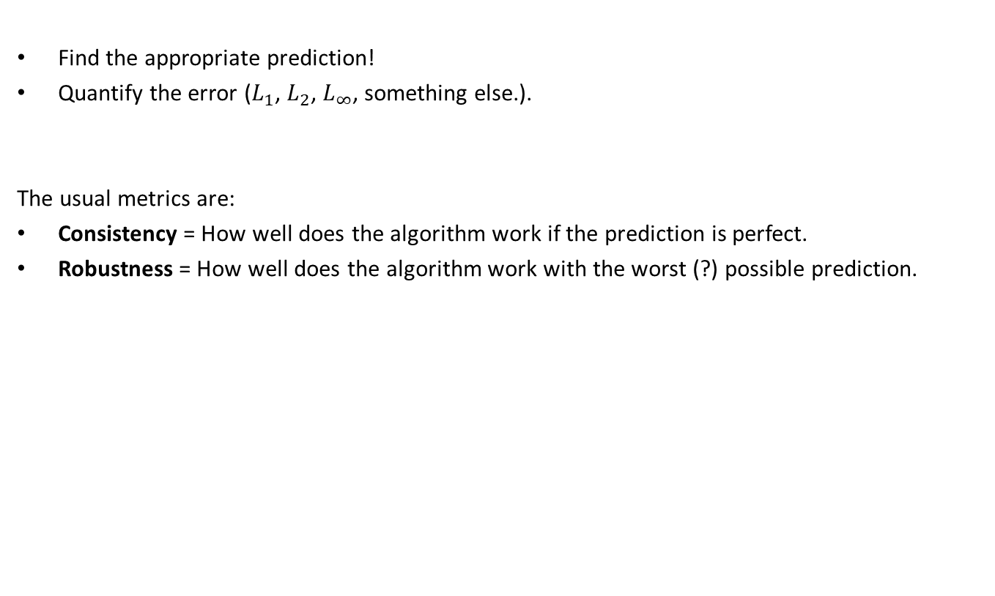
What are we interested in?
Find the appropriate prediction!
Quantify the error ($L_{1}$, $L_{2}$, $L_{∞}$, something else.).
The usual metrics are:
Consistency = How well does the algorithm work if the prediction is perfect.
Robustness = How well does the algorithm work with the worst (?) possible prediction.

Slide 6
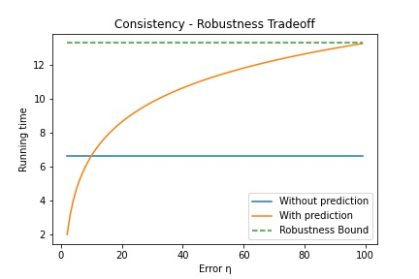

Consistency – Robustness Tradeoff
Learning augmented Binary search has running time $2\log{η}$.
Classic Binary search has running time $\log{n}$, where n is the size of the array.

Slide 7


Combinatorial Auctions – The problem
N bidders:
M items:

Slide 8
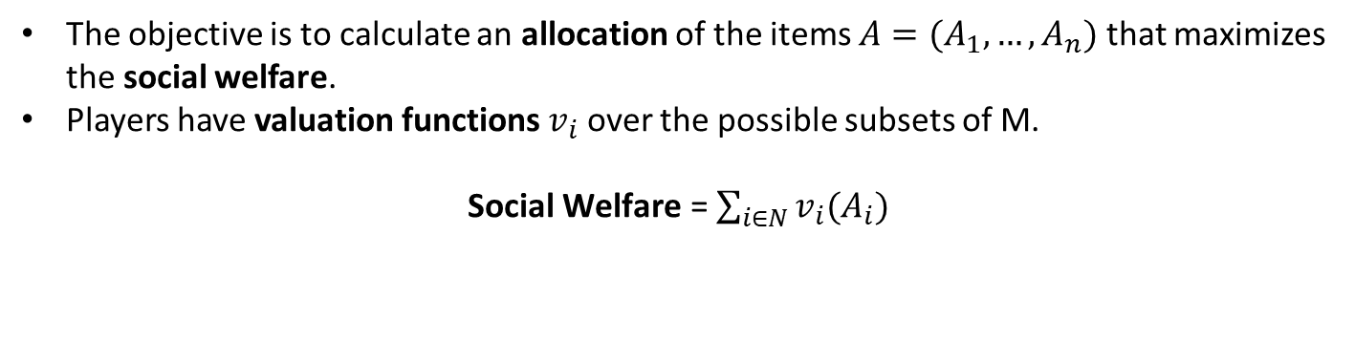
One objective – The Social Welfare
The objective is to calculate an allocation of the items $A=(A_{1}, …,A_{n})$ that maximizes the social welfare.
Players have valuation functions $v_{i}$ over the possible subsets of M.
Social $\text{Welfare}\text{ =}$ $\sum_{i∈N}{v_{i}(A_{i})}$
N bidders:
M items:
In this case the allocation is $A=(\{1,2\},∅,\{3,4\},∅,\{5\})$

Slide 9
Valuations – Bidder 1
N bidders:
M items:
v {1} = 2 v {2} = 3 v {3} = 5 v {4} = 2 v {5} = 2

Slide 10
Valuations – Bidder 1
N bidders:
M items:
v {1} = 2 v {2} = 3 v {3} = 5 v {4} = 2 v {5} = 2
v {1,2} = 5

Slide 11
Valuations – Bidder 1
N bidders:
M items:
v {1} = 2 v {2} = 3 v {3} = 5 v {4} = 2 v {5} = 2
v {1,2} = 5
v {2,3} = 6

Slide 12
Valuations – Bidder 1
N bidders:
M items:
v {1} = 2 v {2} = 3 v {3} = 5 v {4} = 2 v {5} = 2
v {1,2} = 5
v {2,3} = 8
v {3,4} = 5

Slide 13
Valuations – Bidder 1
N bidders:
M items:
v {1} = 2 v {2} = 3 v {3} = 5 v {4} = 2 v {5} = 2
v {1,2} = 5
v {2,3} = 8
v {3,4} = 6
v {4,5} = 3

Slide 14
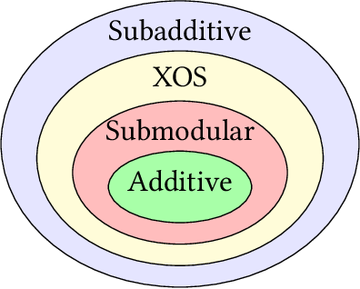

Valuation function classes
Additive: $v\left(S\right)+v\left(T\right)=v\left(S∪T\right)+v\left(S∩T\right) ∀\left(S,T\right)$
Submodular: $v\left(S\right)+v\left(T\right)≥v\left(S∪T\right)+v(S∩T) ∀\left(S,T\right)$
Subadditive: $v\left(S\right)+v\left(T\right)≥v\left(S∪T\right) ∀\left(S,T\right)$

Slide 15
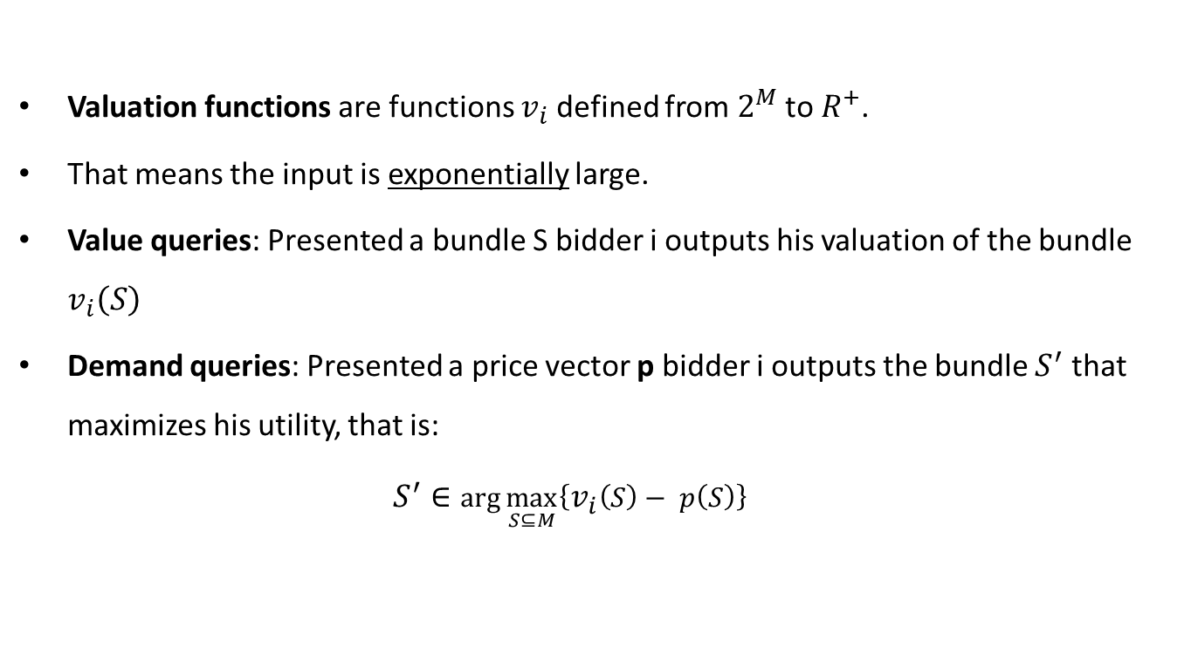
Accessing valuation functions
Valuation functions are functions $v_{i}$ defined from $2^{M}$ to $R^{+}$.
That means the input is exponentially large.
Value queries: Presented a bundle S bidder i outputs his valuation of the bundle $v_{i}\left(S\right)$
Demand queries: Presented a price vector p bidder i outputs the bundle $S^{′}$ that maximizes his utility, that is: $S^{′}∈\arg{\max_{S⊆M}\left\{v_{i}\left(S\right)− p\left(S\right)\right\}}$

Slide 16

Value queries:
$v_{i}\left(\left\{1,2,3\right\}\right)$ = 12
Demand queries:
With these prices I want S = {2,3}
p {1} = 9 p {2} = 3 p {3} = 5

Slide 17
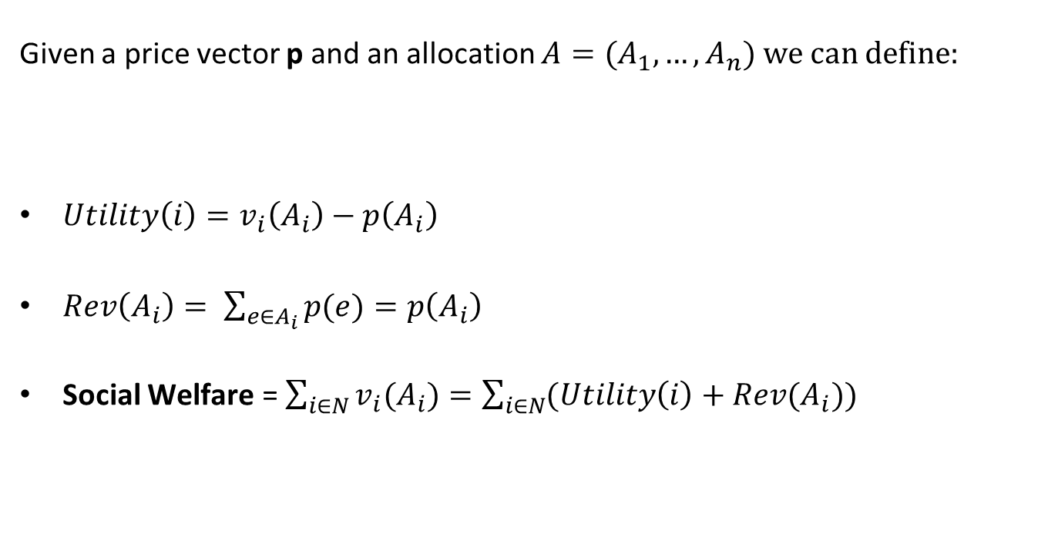
Utility – Revenue and Social Welfare
Given a price vector p and an allocation $A=(A_{1}, …,A_{n})$ we can define:
${Utility\left(i\right)=v}_{i}\left(A_{i}\right)−p\left(A_{i}\right)$
$Rev\left(A_{i}\right)= \sum_{e∈A_{i}}{p(e)}=p\left(A_{i}\right)$
Social $\text{Welfare}\text{ =}$ $\sum_{i∈N}{v_{i}(A_{i})}=\sum_{i∈N}{(Utility\left(i\right)+Rev(A_{i}))}$

Slide 18
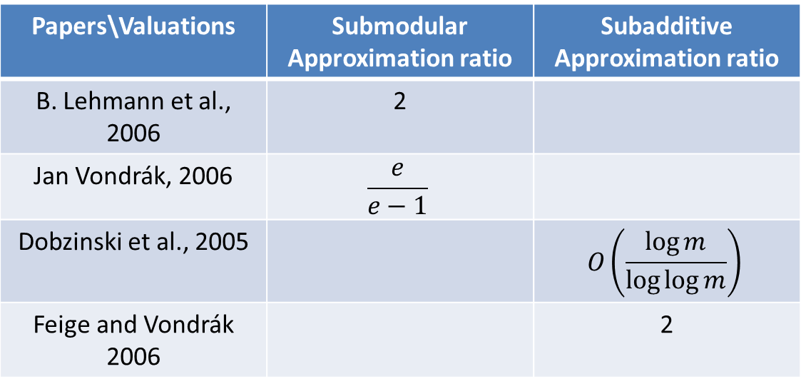
Algorithmic Viewpoint
Can we optimally solve the problem knowing that bidders do not misreport?
The problem for general valuations is NP-hard (set packing).
There are constant approximation algorithms for the algorithmic problem for many valuation function classes.
Papers\Valuations | Submodular Approximation ratio | Subadditive Approximation ratio
B. Lehmann et al., 2006 | 2
Jan Vondrák, 2006 | $$\frac{e}{e−1}$$
Dobzinski et al., 2005 |  | $$O\left(\frac{\log{m}}{\log{\log{m}}}\right)$$
Feige and Vondrák 2006 |  | 2

Slide 19


Algorithmic vs Game Theoretic version
NP-Hard for Submodular and greater classes (set packing reduction).
Constant factor approximations for the Submodular $\left(\frac{e}{e−1}\right)$ and Subadditive $\left(2\right)$ algorithmic problem.
Truthfulness makes the problem much more difficult to approximate.
Papers\Valuations | Submodular Approximation ratio | Subadditive Approximation ratio
Dobzinski et al., 2006 | $$O\left(\log^{2}m\right)$$
P. Krysta and B. Vöcking, 2012 | $$O(\log{m})$$
Dobzinski, 2016 | $$O\left(\sqrt{\log{m}}\right)$$
S. Assadi, S. Singla, 2019 | $O\left({loglog}^{3}m\right)$
Dobzinski et al., 2005 |  | $$O\left(\sqrt{m}\right)$$
Dobzinski, 2007 |  | $$O\left(\log{m}\log{\log{m}}\right)$$
S. Assadi, T. Kesselheim, S. Singla, 2021 | $O\left({loglog}^{2}m\right)$ | $O\left({loglog}^{3}m\right)$

Slide 20
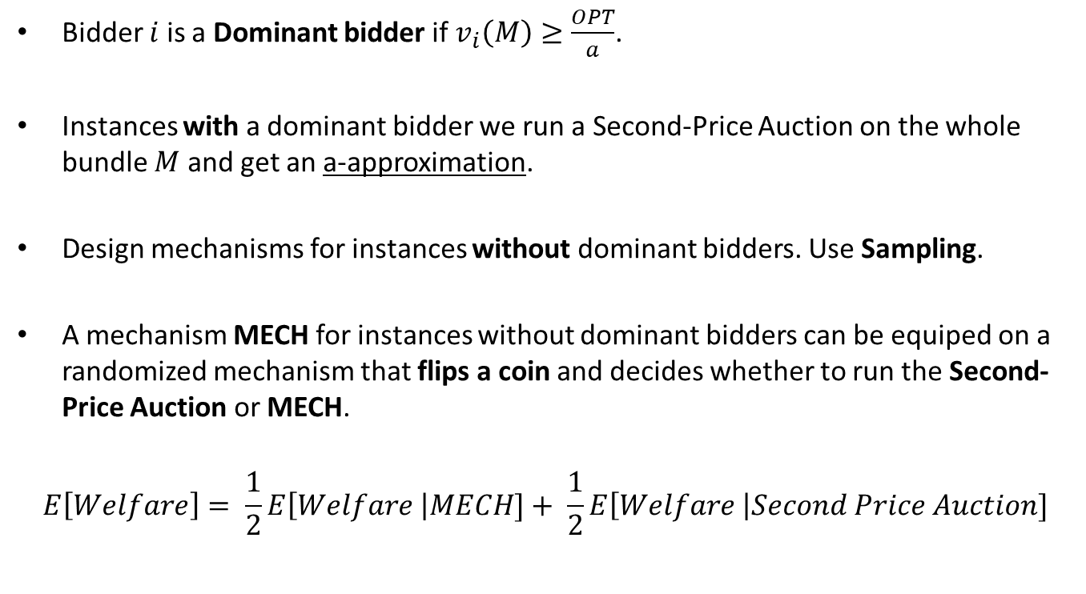
Sampling and Randomization
Bidder $i$ is a Dominant bidder if $v_{i}\left(M\right)≥\frac{OPT}{a}$.
Instances with a dominant bidder we run a Second-Price Auction on the whole bundle $M$ and get an a-approximation.
Design mechanisms for instances without dominant bidders. Use Sampling.
A mechanism MECH for instances without dominant bidders can be equiped on a randomized mechanism that flips a coin and decides whether to run the Second-Price Auction or MECH.
$$E\left[Welfare\right]= \frac{1}{2}E\left[Welfare \right|MECH]+ \frac{1}{2}E\left[Welfare \right|Second Price Auction]$$

Slide 21
Price vectors – Learning procedures
Demand queries require a price vector p.
Truthfulness requires that no bidder can affect her utility by misreporting her valuation.
We need to learn from bidders better prices p but discourage bidders from taking advantage. How?
We design mechanisms that work the problem online.
Bidders come in once, answer their query, get allocated something (sometimes) and leave. This way we ensure learning and also truthfulness.
What can we do with good estimates of the prices?

Slide 22
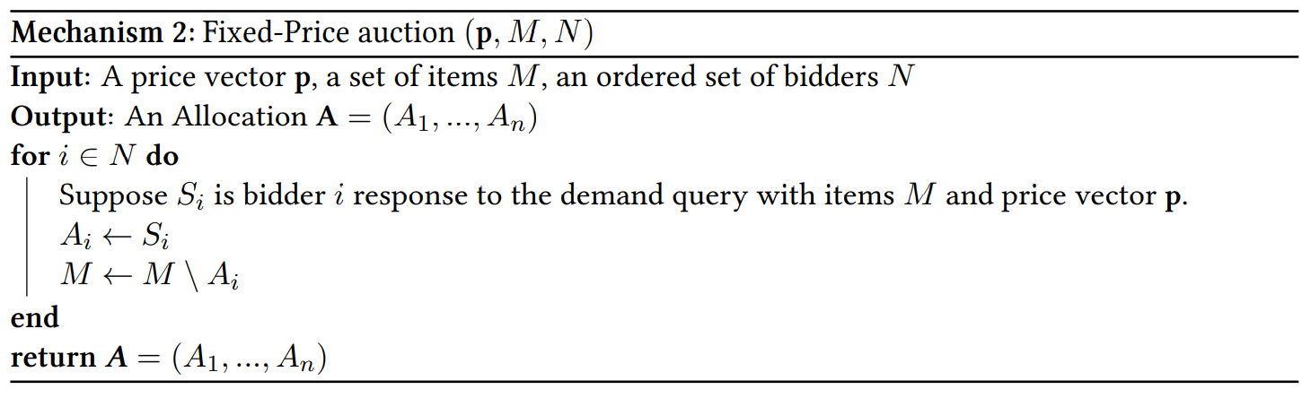
Fixed-Price Auction

Slide 23

Fixed-Price Auction
Allocation
Bidders Sequence
4
1
5
3
Available items

Slide 24

Round 1
Allocation
Bidders Sequence
4
1
Demand query
5
3
Available items

Slide 25
Round 2
Allocation
Bidders Sequence
4
1
Demand query
5
3
Available items

Slide 26
Round 3
Allocation
Bidders Sequence
1
4
Demand query
5
3
Available items

Slide 27
End
Allocation
Bidders Sequence
1
4
5
3
Available items

Slide 28
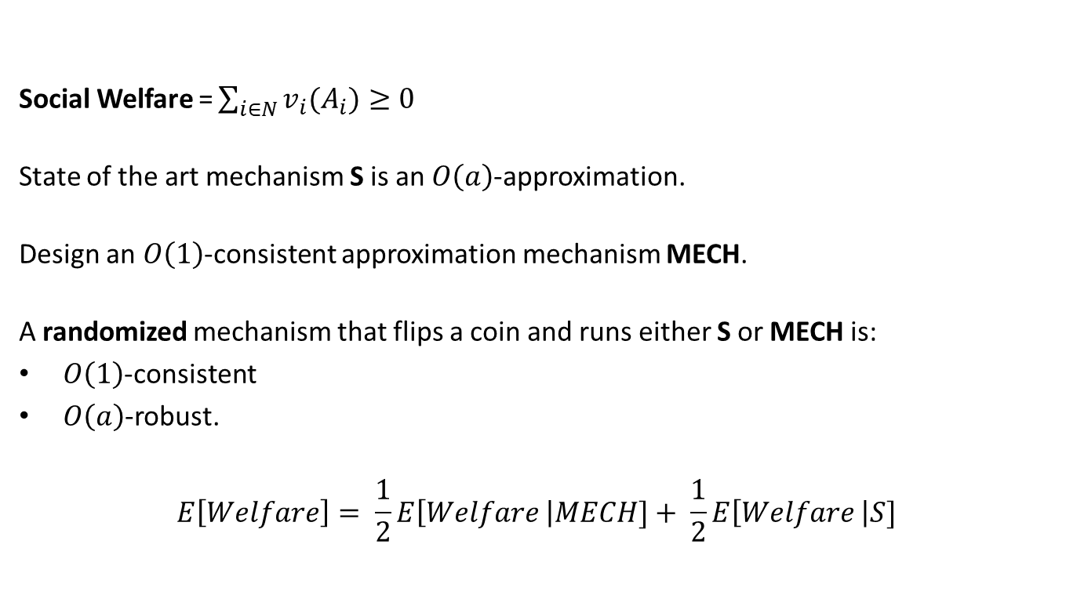
Combinatorial Auctions with predictions
Social Welfare $\text{=}\sum_{i∈N}{v_{i}(A_{i})}≥0$
State of the art mechanism S is an $O\left(a\right)$-approximation.
Design an $O\left(1\right)$-consistent approximation mechanism MECH.
A randomized mechanism that flips a coin and runs either S or MECH is:
$O\left(1\right)$-consistent
$O\left(a\right)$-robust.
$$E\left[Welfare\right]= \frac{1}{2}E\left[Welfare \right|MECH]+ \frac{1}{2}E\left[Welfare \right|S]$$

Slide 29
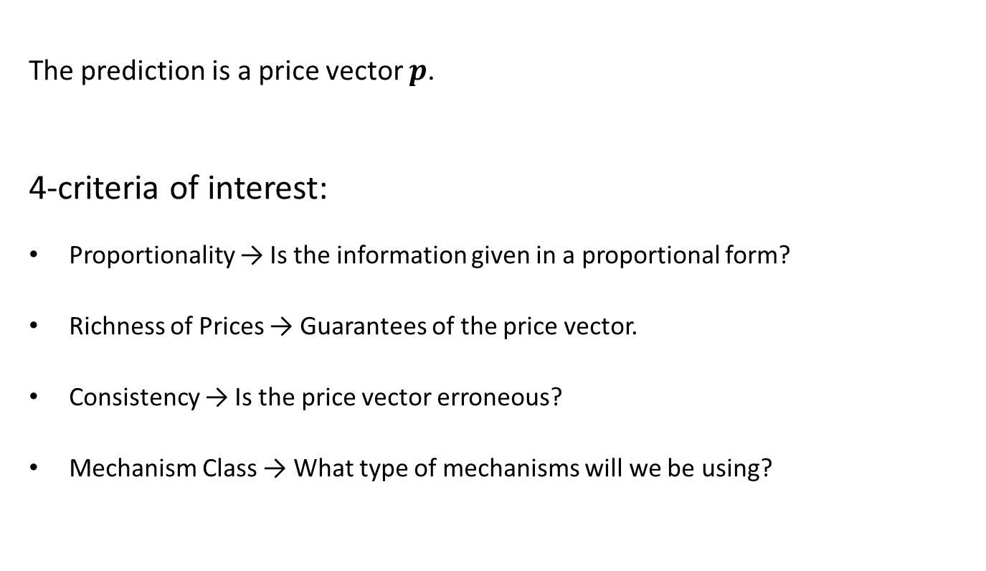
Combinatorial Auctions with predictions
The prediction is a price vector $p$.
4-criteria of interest:
Proportionality → Is the information given in a proportional form?
Richness of Prices → Guarantees of the price vector.
Consistency → Is the price vector erroneous?
Mechanism Class → What type of mechanisms will we be using?

Slide 30
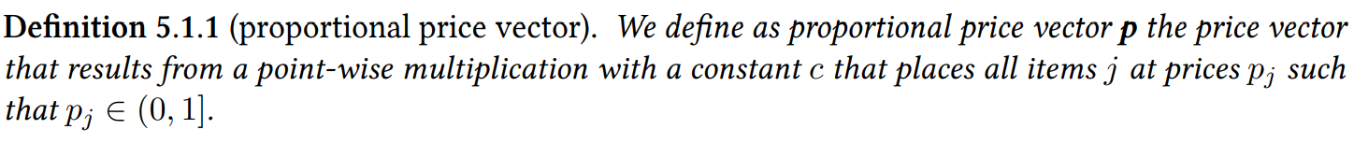


Proportionality
$$[8,4,16]$$
$$[0.5,0.25,1]$$
price vector with some property
corresponding proportional price vector

Slide 31
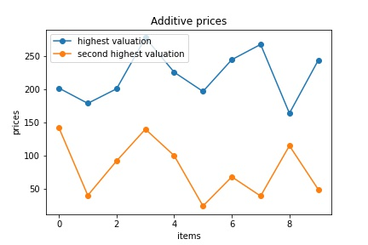
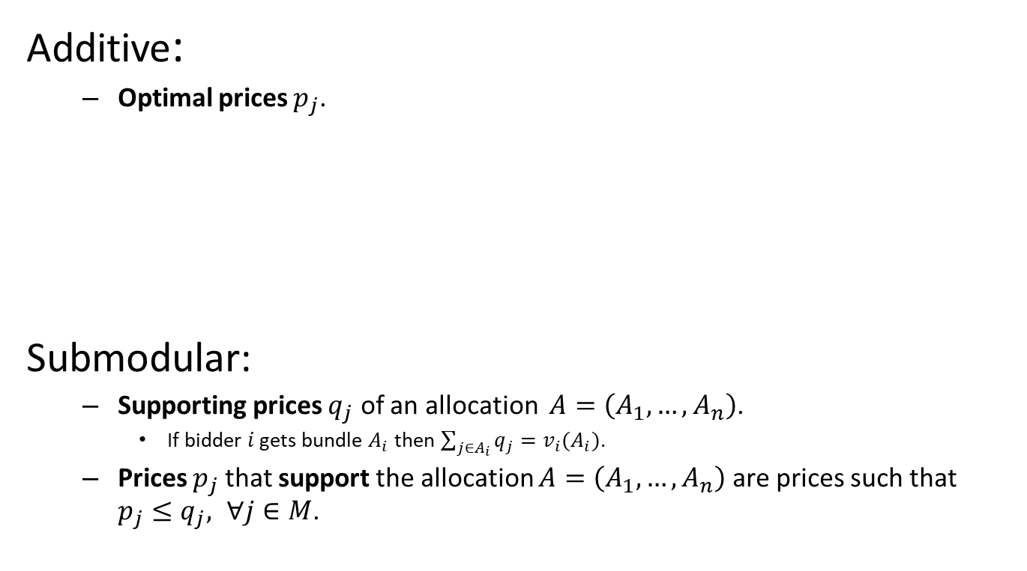
Richness of prices
Additive:
Optimal prices $p_{j}$.
Submodular:
Supporting prices $q_{j}$ of an allocation $A=\left(A_{1},…,A_{n}\right)$.
If bidder $i$ gets bundle $A_{i}$ then $\sum_{j∈A_{i}}{q_{j}}=v_{i}(A_{i})$.
Prices $p_{j}$that support the allocation $A=\left(A_{1},…,A_{n}\right)$ are prices such that $p_{j}≤q_{j}, ∀j∈M$.

Slide 32
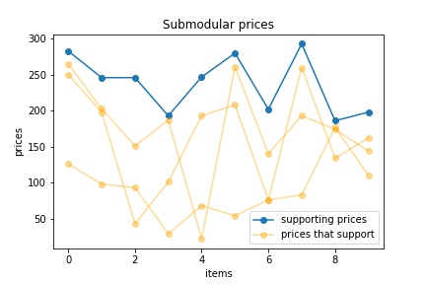
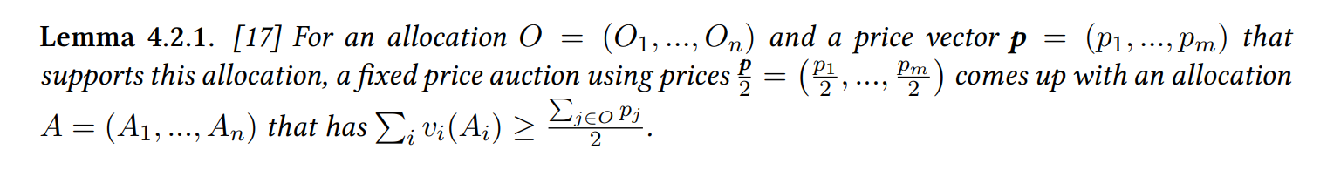

Slide 33










Sampling & Multiplying Mechanisms
Prediction vector $p$
$$p=[8,4,16]$$
$$p^{′}=[4,2,8]$$
Split
Estimate Optimal Solution $OPT′$ restricted on $N_{Sample}$
Rescale price vector $p^{′}=\frac{{OPT}^{′}}{d|p|}p$
Bidders $N$
$$N_{Sample}$$
$$N_{Post}$$
Fixed-Price Auction$\left(p^{′},M,N_{Post}\right)$
Final Allocation $A$

Slide 34


Additive Class - The Sampling Mechanism
Prediction vector $p$
Optimal proportional price vector
Virtual Vickrey Auctions
Split
Estimate Optimal Solution $OPT′$ restricted on $N_{Sample}$
Rescale price vector $p^{′}=\frac{{OPT}^{′}}{d|p|}p$
Bidders $N$
$$N_{Sample}$$
$$N_{Post}$$
Uniform $d = \left\{8,64\right\}$
Fixed-Price Auction$\left(p^{′},M,N_{Post}\right)$
i.i.d. with probability $\frac{1}{2}$
Final Allocation $A$

Slide 35
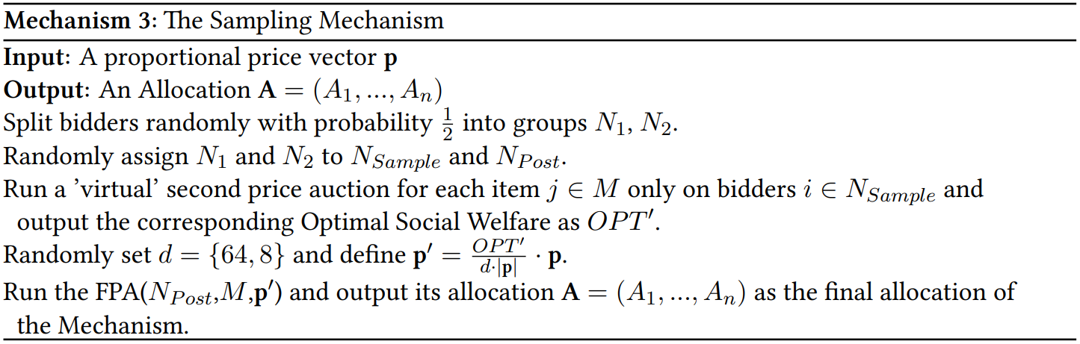
The Sampling Mechanism

Slide 36
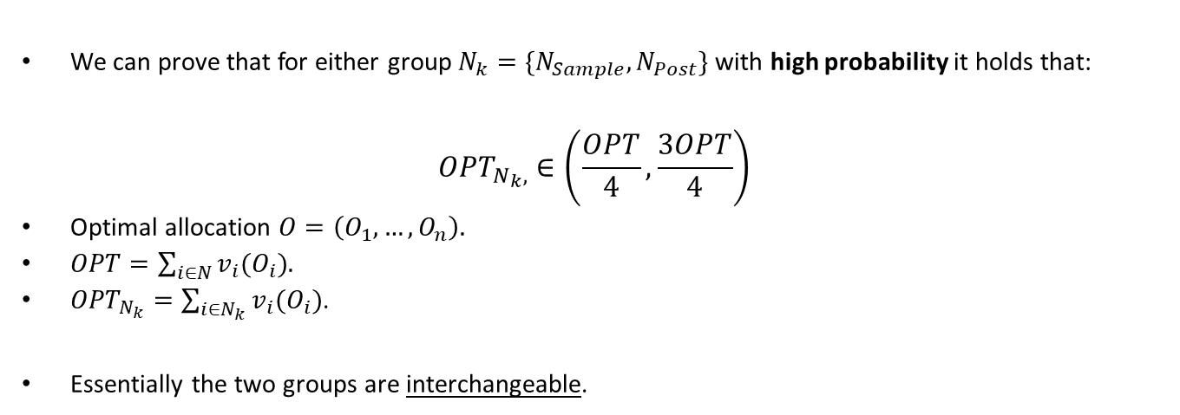



The power of i.i.d. splitting
We can prove that for either group $N_{k}=\{N_{Sample},N_{Post}\}$ with high probability it holds that:
$${OPT}_{N_{k},}∈\left(\frac{OPT}{4},\frac{3OPT}{4}\right)$$
Optimal allocation $O=\left(O_{1},…,O_{n}\right)$.
$OPT=\sum_{i∈N}{v_{i}(O_{i})}$.
${OPT}_{N_{k}}=\sum_{i∈N_{k}}{v_{i}(O_{i})}$.
Essentially the two groups are interchangeable.
$$N_{Sample}$$
$$N$$
Split
Colorful bidders are allocated some item(s) in the optimal allocation.
$$N_{Post}$$

Slide 37
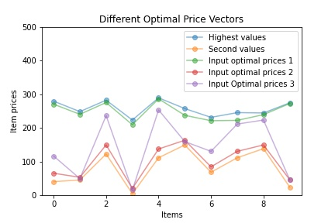
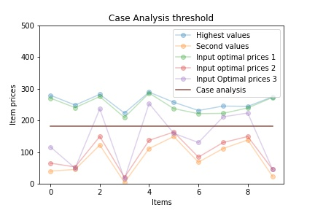
Handling different optimal price vectors

Slide 38
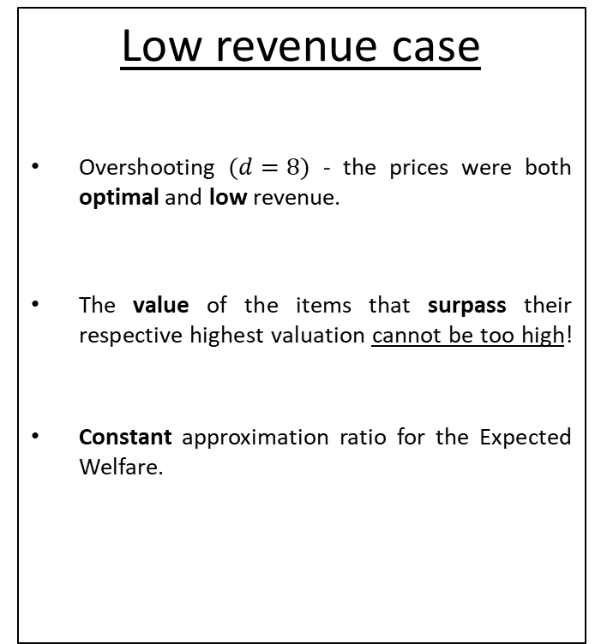
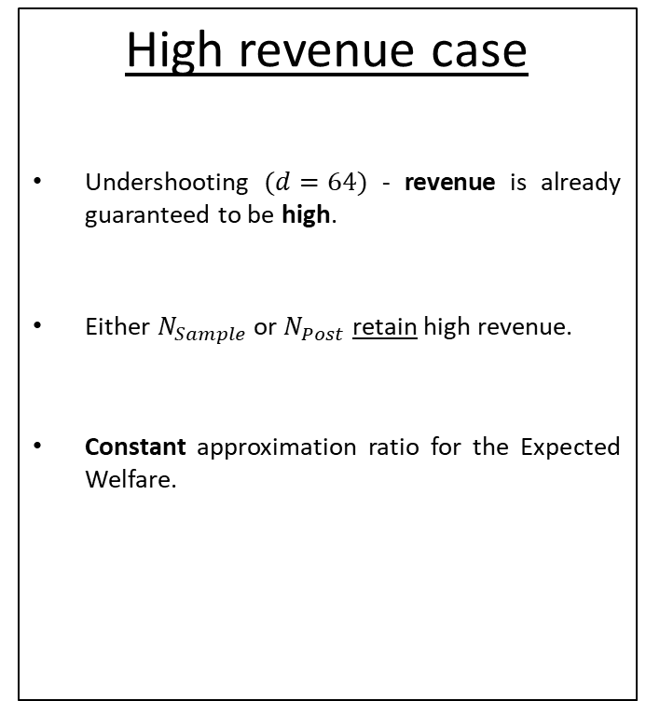
Case analysis on the initial price vector
High revenue case
Undershooting $(d=64)$ - revenue is already guaranteed to be high.
Either $N_{Sample}$ or $N_{Post}$ retain high revenue.
Constant approximation ratio for the Expected Welfare.
Low revenue case
Overshooting $(d=8)$ - the prices were both optimal and low revenue.
The value of the items that surpass their respective highest valuation cannot be too high!
Constant approximation ratio for the Expected Welfare.

Slide 39
Approximation ratio
The approximation ratio is $\frac{e^{2}−2}{2048e^{2}}$

Slide 40

Submodular – Proportional – Supporting prices of the optimal allocation
Supporting prices $q$ add up to exactly $OPT$.
Estimate $OPT$ in the sample (Non Truthfully -> 2 approximation).
Bound $p^{′}$ such that $p^{′}<\frac{q}{2}$ and $\sum_{j∈M}{{p′}_{j}}$ is lower bounded.
Run a Fixed-Price Auction $p^{′}$. Result holds due to the previous Lemma.

Slide 41
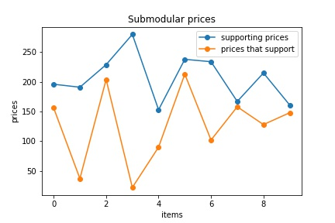

Submodular – Prices that support the optimal allocation
Proportional prices that support the optimal allocation have no meaningful guarantee (e.g. $\left[0,…,0\right]$).
Low revenue case can’t work.
Select prices such that some of the items are nearly overpriced while the rest are severely underpriced.
Non-proportionally we can observe these prices $p$ as erroneous predictions, define the error $η=\max_{j}\left\{\frac{q_{j}}{p_{j}}\right\}$ and get the following theorem:

Slide 42
a-good price vector
Re-examine Additive problem.
Check Low Revenue case for the Submodular problem.

Slide 43
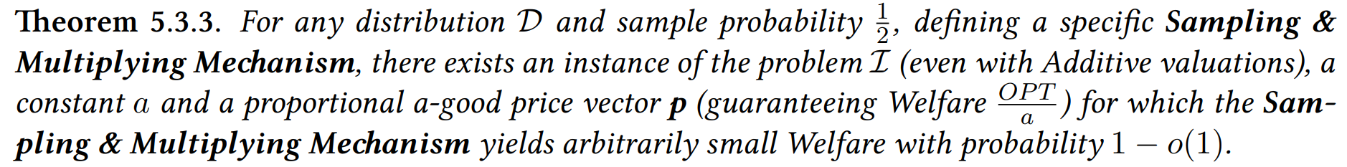
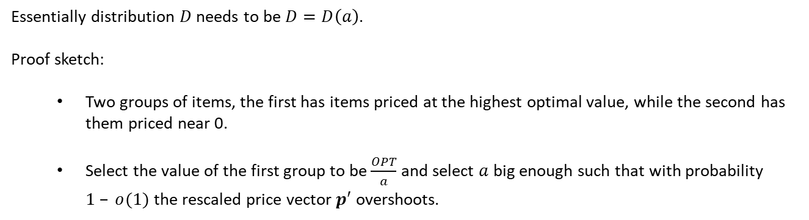
Proportionality - Bad news 1
Essentially distribution $D$ needs to be $D=D\left(a\right)$.
Proof sketch:
Two groups of items, the first has items priced at the highest optimal value, while the second has them priced near 0.
Select the value of the first group to be $\frac{OPT}{a}$ and select $a$ big enough such that with probability $1 – o(1)$ the rescaled price vector $p′$ overshoots.

Slide 44
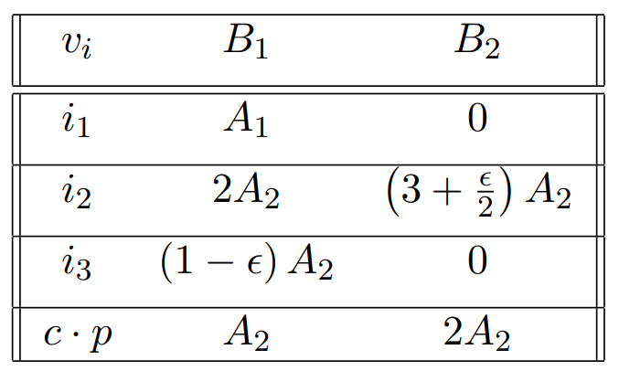
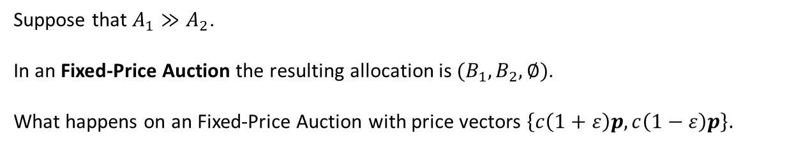
Non-Proportionality
Suppose that $A_{1}≫A_{2}$.
In an Fixed-Price Auction the resulting allocation is $(B_{1}, B_{2},∅)$.
What happens on an Fixed-Price Auction with price vectors $\left\{c\left(1+ε\right)p,c\left(1−ε\right)p\right\}.$

Slide 45
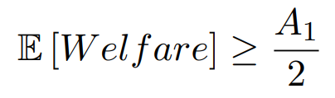


With price vector $c\left(1+ε\right)p$
Allocation $(B_{1}, B_{2},∅)$ if bidder $i_{1}$ comes before bidder $i_{2}$.
Allocation $(∅, B_{1}, ∅)$ if bidder $i_{2}$ comes before bidder $i_{1}$.

Slide 46


With price vector $c\left(1−ε\right)p$
Allocation $(B_{1}, B_{2},∅)$ if bidder $i_{1}$ comes before bidder $i_{3}$.
Allocation $(∅, B_{2},B_{1})$ if bidder $i_{3}$ comes before bidder $i_{1}$.

Slide 47
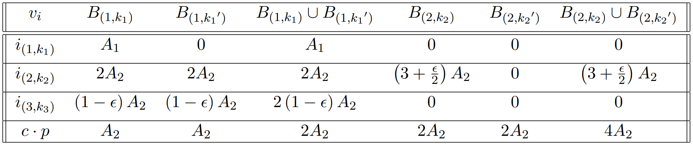
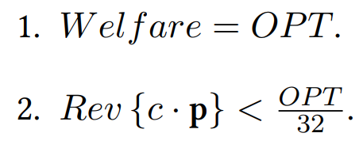
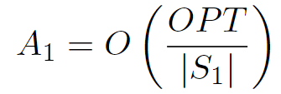
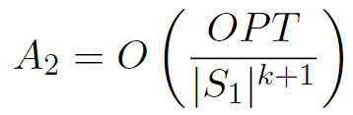

Low Revenue Family of Instances
Groups $S_{1},S_{2}$, $S_{3}$ with representative bidders $i_{(1,k_{1})}$, $i_{(2,k_{2})}$, $i_{(3,k_{3})}$ respectively.
Instance guarantees
$\left|S_{1}\right|$ is left as a parameter.

Slide 48

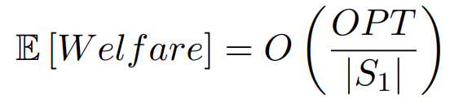
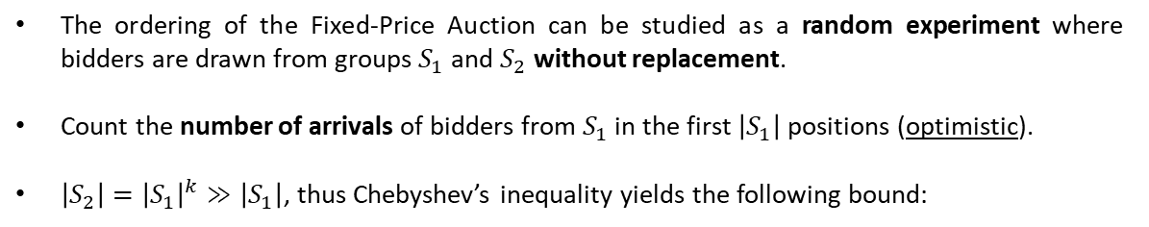


With price vector $c\left(1+ε\right)p$
only
either
only
or
only
or
Group $S_{1}$
Group $S_{2}$
The ordering of the Fixed-Price Auction can be studied as a random experiment where bidders are drawn from groups $S_{1}$ and $S_{2}$ without replacement.
Count the number of arrivals of bidders from $S_{1}$ in the first $\left|S_{1}\right|$ positions (optimistic).
$\left|S_{2}\right|={\left|S_{1}\right|}^{k}≫\left|S_{1}\right|$, thus Chebyshev’s inequality yields the following bound:

Slide 49
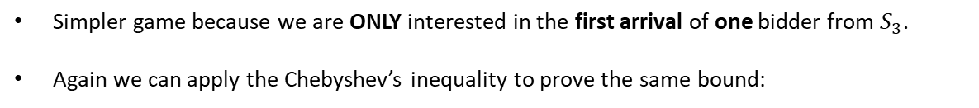

With price vector $c\left(1−ε\right)p$
only
all
only
all
only
all
Group $S_{1}$
Group $S_{3}$
Simpler game because we are ONLY interested in the first arrival of one bidder from $S_{3}$.
Again we can apply the Chebyshev’s inequality to prove the same bound:

Slide 50
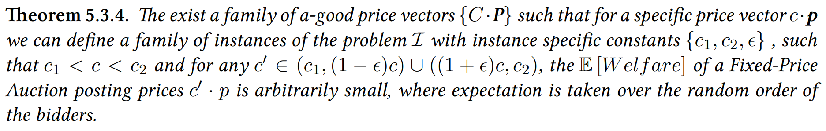
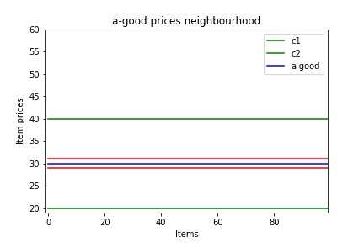
Bad News 2.

Slide 51

Quick Recap
Price vector prediction
Non-proportional & erroneous
Proportional & Consistent
Additive
Submodular
a-good prices
Arbitrarily bad in a neighborhood
Perturbed a-good prices
Arbitrarily bad for constant step
Prices that support
$2η$-approximation
Optimal prices
Constant approximation
Supporting prices
Constant approximation
Prices that support
Arbitrarily bad

Slide 52
Thank you!

